Slide 1


Plant Disease Detection using Deep Learning
Name : Buchipalli Nikhilaanandam
AICTE ID : STU64ef786a24f201693415530

Slide 2

Learning Objectives
1.Understand how Convolutional Neural Networks (CNNs)
Learn the role of CNNs in image-based plant disease detection.
2.Explore Deep Learning classification across 38 plant disease classes
Recognize how DL models can handle multiclass classification effectively.
3.Identify and evaluate key performance metrics
Accuracy, Precision, Recall, F1-Score, and Confusion Matrix interpretation.
4.Evaluate the results through training graphs and visual outputs.
5.Relate the model to real-world agricultural applications
Learn how DL models help farmers and agronomists in early disease diagnosis.
6.Evaluate model effectiveness through audience interaction
Encourage feedback and assess understanding of DL-based classification.
7.Identify potential improvements and extensions using transfer learning and model deployment techniques.
GOAL
Source :
www.freepik.com/

Slide 3



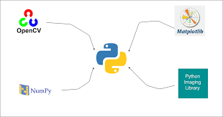
Tools and Technology used
👨‍💻 Programming Language
Python 3 Used for implementing deep learning pipelines and image processing.
📚 Framework / Library
TensorFlow & Keras Used to build and train the Convolutional Neural Network (CNN) model.
🧪 Development Environment
Google Colab Cloud-based notebook environment with GPU support.
🗃Data Source
Kaggle Dataset New Plant Diseases Dataset (Augmented)
📦 Supporting Libraries
NumPy – numerical operations
Pandas – data manipulation
Matplotlib / Seaborn – visualization
OpenCV – image handling

Slide 4
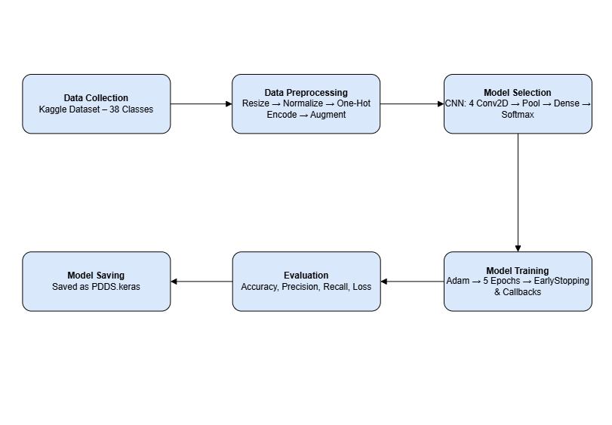
Methodology

Slide 5
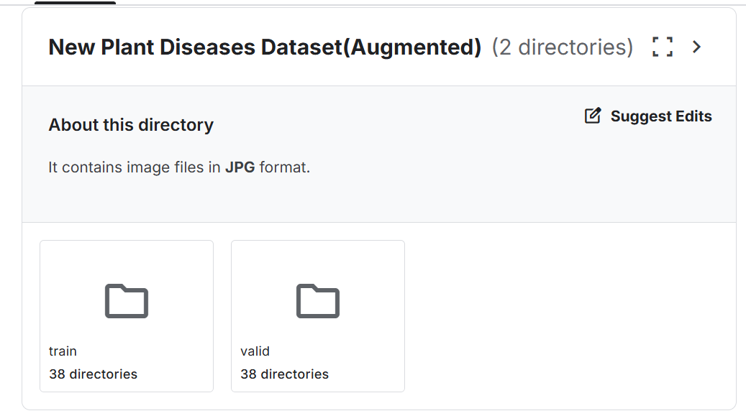
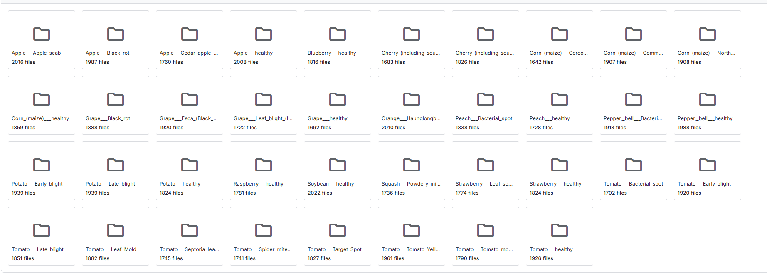
Methodology
1.Data Collection
Dataset sourced from Kaggle
Contains 38 different classes of plant diseases
Images organized into train, validation, and test folder

Slide 6
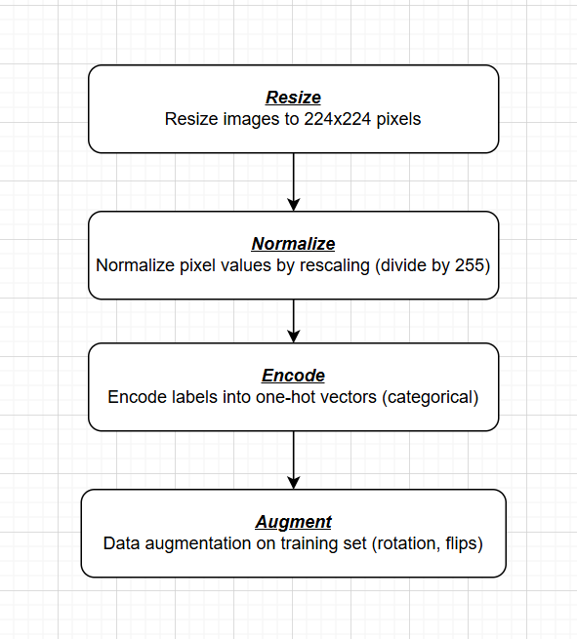
Methodology
2. Data Preprocessing
3. Model Selection
Designed a custom CNN architecture
4 Convolutional layers + MaxPooling layers
Dense fully connected layers at the end
Output layer with softmax activation for 38 classes
Callbacks used:
Early Stopping,
Model Checkpoint,
Reduce LROnPlateau
Conv2D Layers stacked
Pooling
Flatten
Dense
Output

Slide 7
Methodology
5. Evaluation
Evaluate model on test dataset
Metrics reported: Loss, Accuracy, Precision, Recall
Visualization of training and validation accuracy over
epochs
Save the final trained model for deployment
4. Model Training
Training using Adam optimizer
Loss function: categorical crossentropy
Metrics tracked: accuracy, precision, recall
Batch size of 164, trained for 5 epochs with early stopping
Input
Training Loop
Metrics Evaluation
Early Stopping Trigger

Slide 8
Problem Statement:
🌱 Real-World Agricultural Challenge
In large-scale farming, plant diseases can significantly impact crop yield and food supply. Detecting these diseases early is crucial for minimizing damage and maintaining crop health.
❌ Limitations of Manual Disease Identification
Time-Consuming: Requires visual inspection of leaves, which is slow when scaled to hundreds or thousands of plants.
Resource-Intensive: Depends on trained agricultural experts and manual labor.
Human Error: Prone to inconsistent or inaccurate diagnoses due to fatigue or lack of expertise.
Scalability Issues: Difficult to implement across large farms or remote areas.
💡 Our Proposed Solution
To address these real-world challenges, we propose an automated solution using a Convolutional Neural Network (CNN) model trained on a publicly available plant disease dataset.
Capable of learning complex visual patterns from leaf images
Automatically identifies and classifies 38 plant disease categories
Fast and scalable for real-time implementation
✅ Real-World Benefits
Speed: CNNs process images in milliseconds Accuracy: High precision and recall in classification tasks
Efficiency: Reduces reliance on human experts and manual inspection
Scalability: Can be integrated into mobile apps or embedded systems for field use

Slide 9
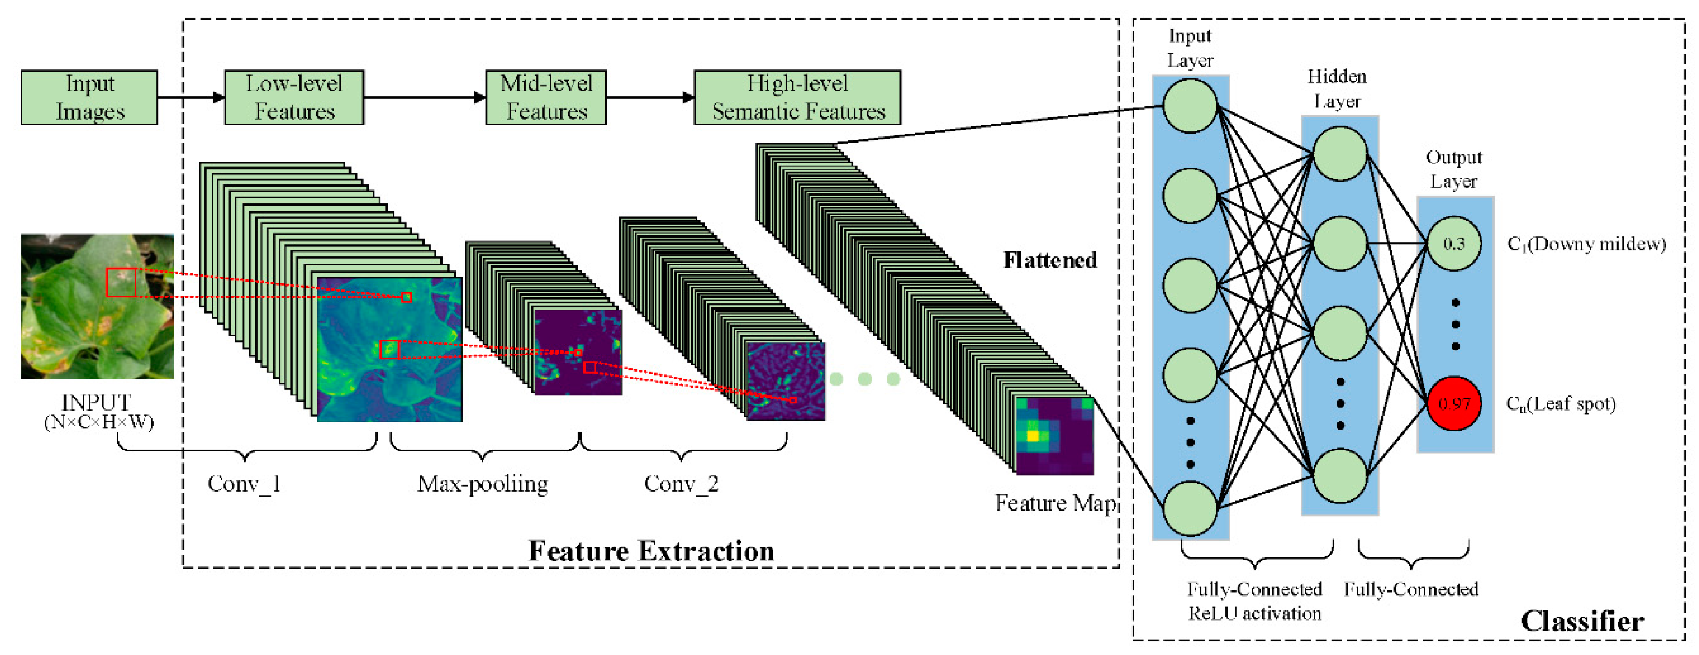
Solution:
🌿 Deep Learning-Based Disease Detection
We developed a Convolutional Neural Network (CNN) model to automatically detect and classify 38 different
plant diseases from leaf images using a Kaggle dataset.
🔍 How the Model Works
1.Input: Leaf image of a plant
2.CNN Architecture: ‣ 4 Convolutional Layers ‣ Max Pooling, Dropout for regularization ‣ Dense layers with ReLU activation ‣ Output layer with Softmax for multi-class
classification
Github : https://github.com/bnikhil3/Plant_Disease_Detection

Slide 10
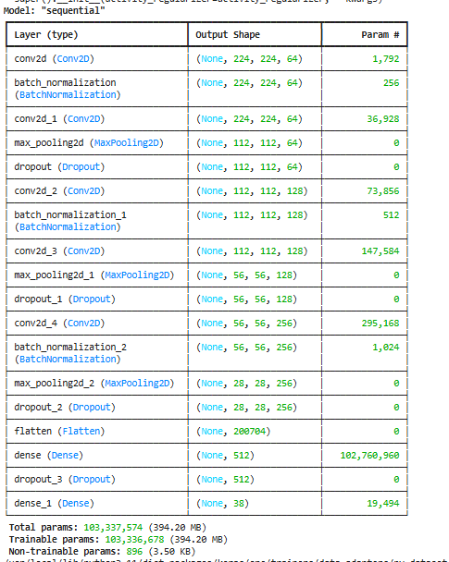
Solution:
3.Training Strategy: ‣ Early Stopping to avoid overfitting ‣ Model Checkpointing for saving the best model ‣ Optimized using Adam with Categorical Crossentropy
📈 Model Performance
Accuracy Achieved: ~90%
Precision & Recall: High across multiple classes
Real-Time Predictions: Inference takes milliseconds
🌟 What Makes This a Cutting-Edge Solution
Prevents Disease Spread: Early identification allows timely intervention
Fast & Scalable: Can be deployed on edge devices and mobile apps
Efficient Resource Usage: Reduces dependence on manual labor and expert agronomists
Supports Smart Agriculture: Contributes to sustainable and tech-driven farming practices
Github : https://github.com/bnikhil3/Plant_Disease_Detection

Slide 11
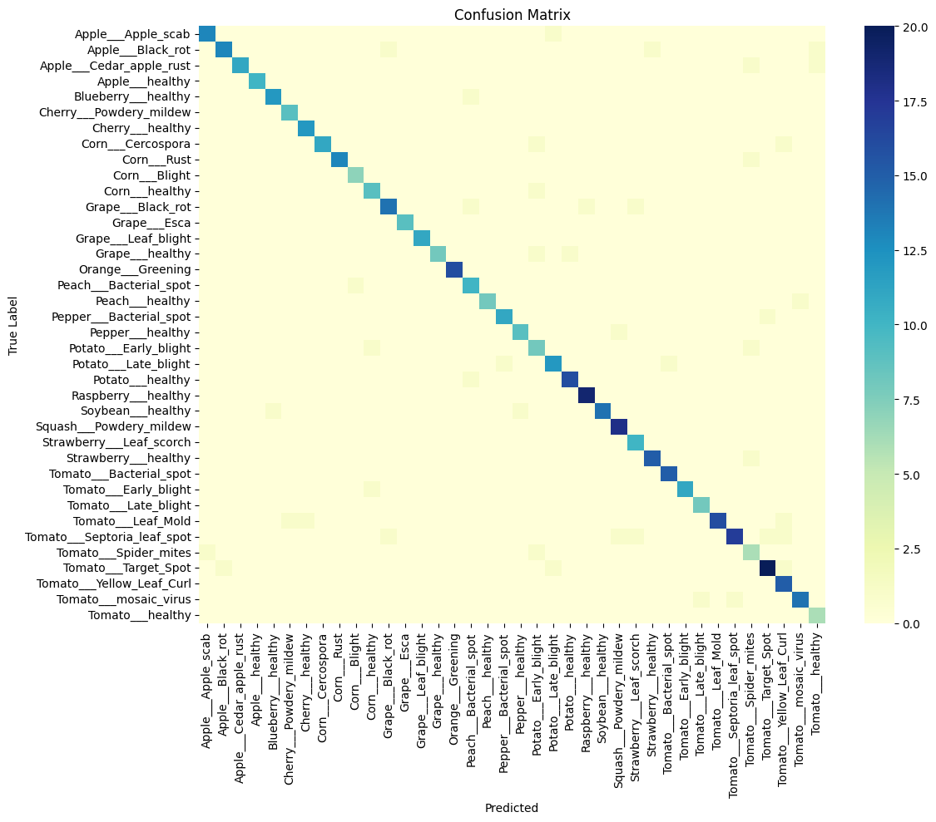
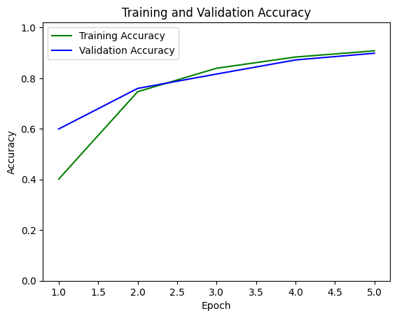
Screenshot of Output:

Slide 12
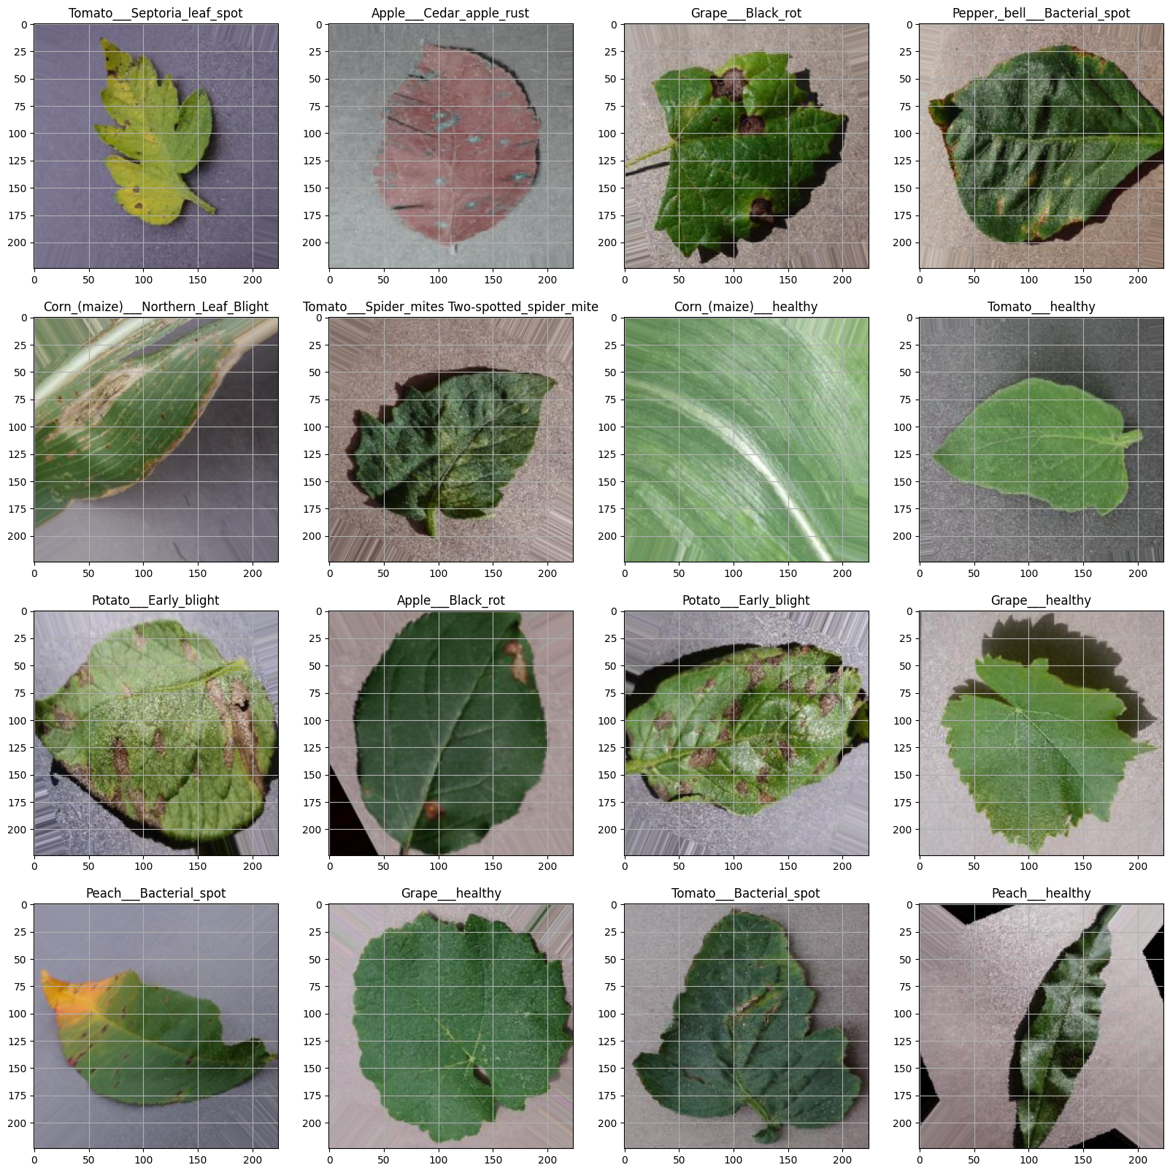
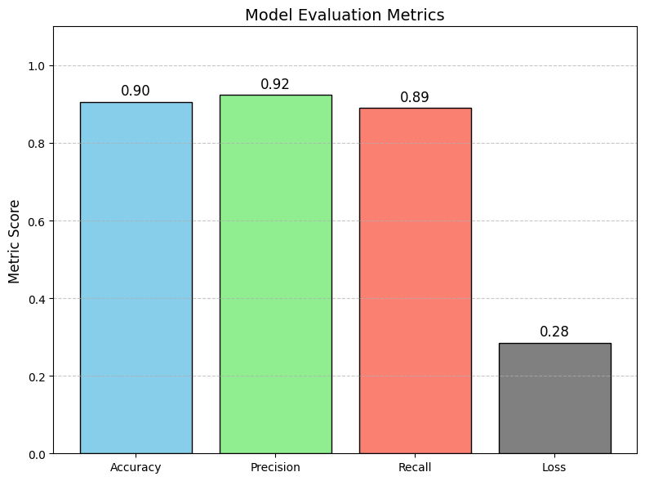
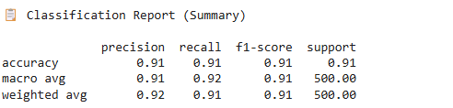
Screenshot of Output:

Slide 13
Conclusion:
🔚 Conclusion
Successfully developed a Convolutional Neural Network (CNN) model to classify 38 different plant diseases using leaf images.
Achieved a strong accuracy of ~90%, demonstrating the strength of deep CNN layers in learning complex features.
Applied key optimization and regularization techniques such as:
Adam optimizer
Dropout to prevent overfitting
Early stopping and model checkpointing for efficient training
The project emphasizes how deep learning can be effectively utilized in real-world agricultural applications to automate disease detection and prevention.
🔮 Future Scope
Expand the model to cover more than 38 classes by training on larger, diverse datasets.
Explore better optimizers like RMSProp or learning rate schedulers for further improvements.
Fine-tune hyperparameters using advanced techniques (e.g., grid search, Bayesian optimization).
Improve generalization across rare and underrepresented plant species to help preserve biodiversity.
Deploy the model using tools like Streamlit for real-time web-based interfaces accessible to farmers and researchers.
Potential to integrate with mobile apps, drones, and IoT for smarter, on-field plant health monitoring.

